Slide 1
IMPLEMENTATION OF FUNDAMENTALS OF LOGIC
Ms. Shivani V Banke 2GI20CS140
Ms. Shradha Mallikarjun Patil 2GI20CS144
Ms. Srushti B Mudennavar 2GI20CS158
Mr. Yash Herekar 2Gi20CS184

Slide 2
ABSTRACT :
Implementation of compound logical proposition equivalences using python language.

Slide 3
WHAT IS LOGIC ?
A science that deals with the principles and criteria of validity of inference and demonstration
In simple way a proper or reasonable way of thinking about something
It helps us to understand reasoning behind issues which could be applied in other issues as well

Slide 4
METHODOLOGY : Laws of logic :
Laws of logic are the Basic laws of Propositional Logi
Fundamentally there are three laws of logic
1)The law of contradiction : not( a and not a)
2)The principle of identity : a is a
3)The law of excluded middle : either “a” or not “a”

Slide 5
APPLICATIONS OF LAWS OF LOGIC:
Translating English Sentences into logical statements
Logical Puzzles : They can be used for brain exercises, recreational purposes, and for testing a person’s reasoning capabilities
Logic/Computer Circuits
Artificial Intelligence – Fuzzy Logic : in fuzzy logic, there is an intermediate value too present which is partially true and partially false.
Inference and Decision Making
System Specifications

Slide 6
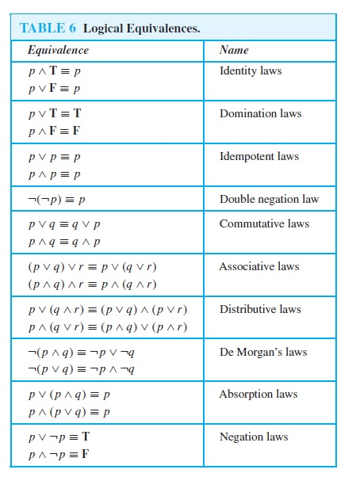
LAWS OF LOGIC:

Slide 7
PROBLEM STATEMENT :
Given the truth values of propositions p&qa)
Construct the truth table for De Morgan’s Laws & Law’s of Negation of a conditional & Distributive Law.b)
Write a program with specified Input & output for p&q, then construct the truth table for Demorgan’s Law’s & Negation of conditional & Distributive Law.

Slide 8
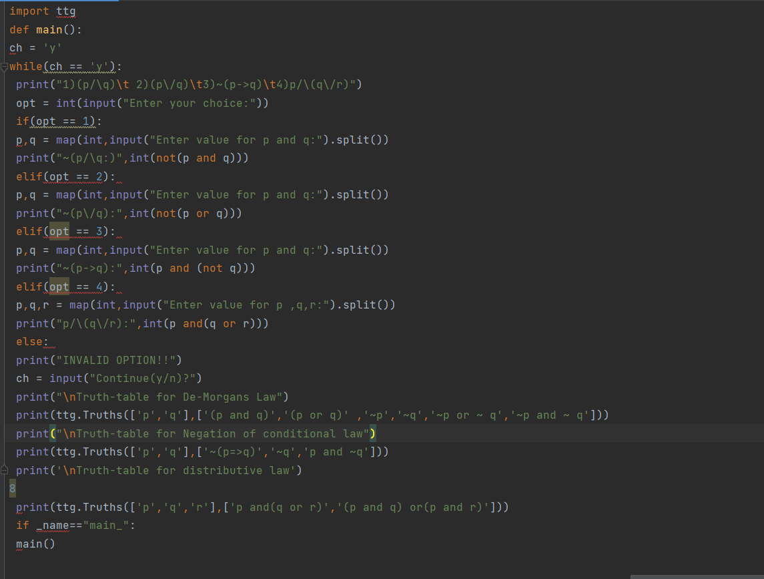
SOURCE CODE:

Slide 9
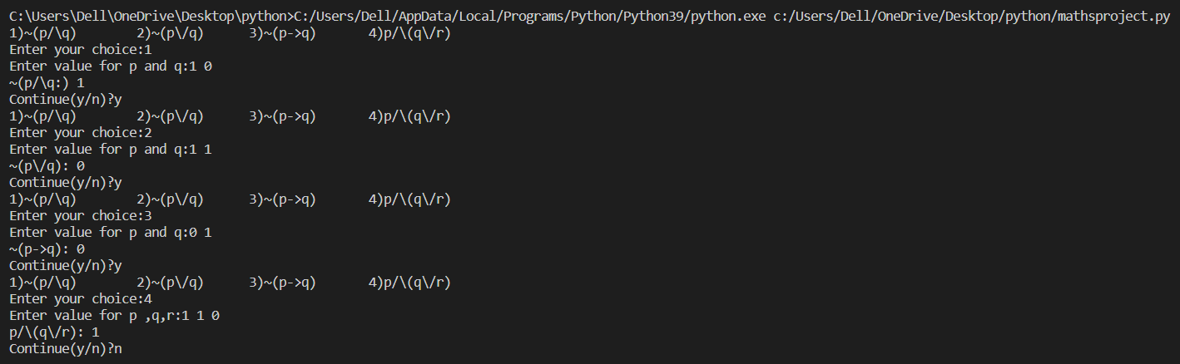
OUTPUT:

Slide 10
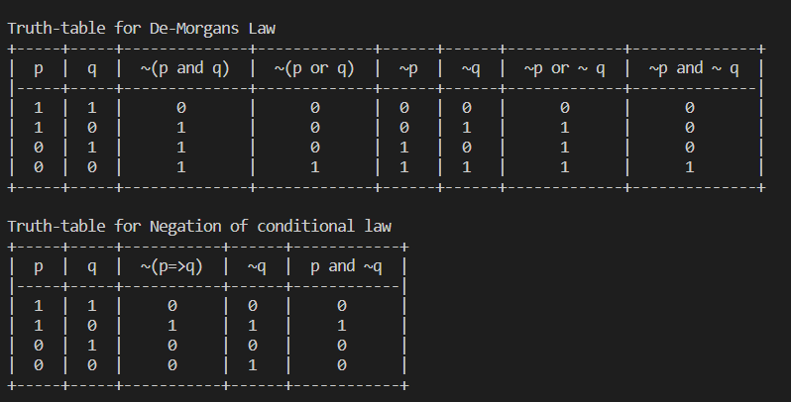
OUTPUT:

Slide 11
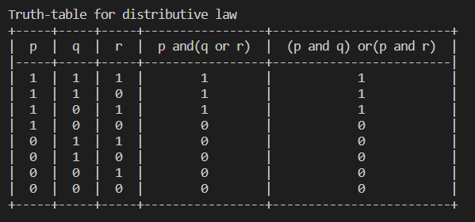
OUTPUT:

Slide 12
CONCLUSION:
In this course activity we have learnt about laws of logic and how to solve basic expressions using them. Also we learnt to solve the given expression using programming language in our case python, to get the complete truth table of given expression or solve the expression for a given set of values of variable.

